Slide 1
INTUIT DEMO

Slide 2
Problem statement
A vehicle fleet company has telematic devices fitted in their vehicles. These devices emit constant data which
need to be sent to the backend. The data emitted is as below
● Latitude and longitude of the vehicle at the given time
● Percent of fuel left at the given time
● Vehicle speed at the given time
You need to design the backend system which
● Can receive and save the data from the vehicles telematics devices
● Generate these reports from this data
○ Total distances covered by each vehicle - daily /monthly
○ How many vehicles did overspeeding & details of each overspeeding vehicle - daily/monthly
● Design the system in such a way that 3rd party developers can leverage the APIs of this platform for
building new capabilities around the data available.
● Design the system to have monitoring and execute a set of actions based on rules (for e.g. send a
notification if speed is above 80 kmph). System should be able to configure different actions and
rules.

Slide 3
Assumptions
Some assumptions
Device will transmit new uuid every time when engine starts
Device will transmit the last known geolocations where it was previously
Basic Vehicle Simulator
Consideration only on road vehicles
Fuel is full when the vehicle starts
Vechile will emit events with the delay of 10 seconds

Slide 4
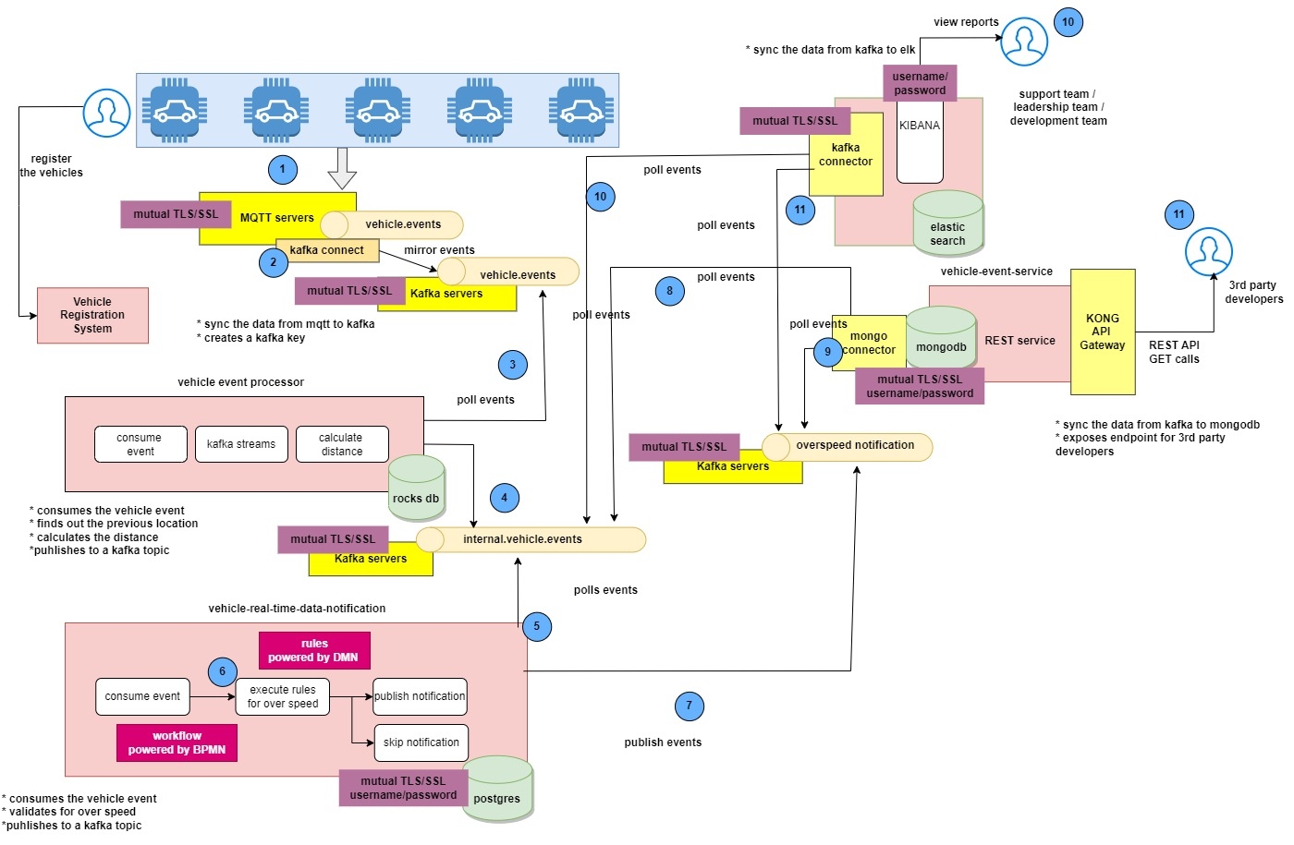
Architecture

